Slide 1
ENPM809B - Final Project (ARIAC 2020 Competition) - Group #3
Eashwar Sathyamurthy (UID - 116946148)
Mushty Sri Sai Kaushik (UID - 116917094)
Akwasi A. Obeng (UID - 11700801)
Shantam Bajpai (UID - 116831956)

Slide 2
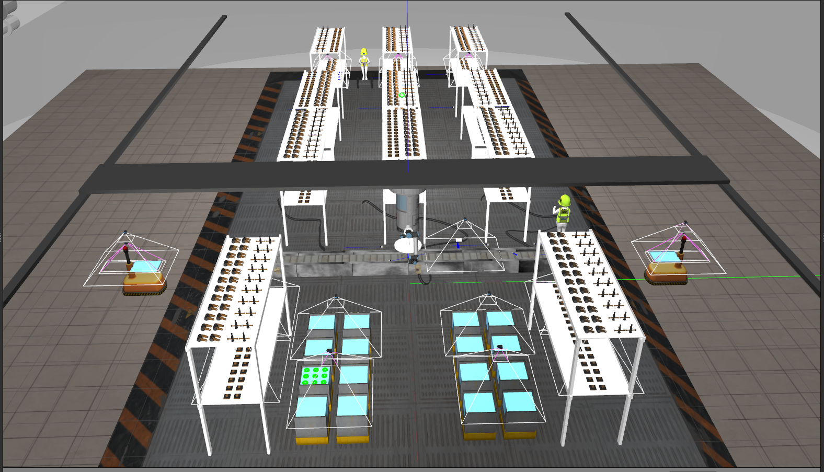
Environment

Slide 3
Environment details
The various parts of the environment include:
Dual six DoF UR10 arm Gantry Robot
Conveyor belt
11 product shelves including 3 dynamic shelves
16 product bins
Parts: piston, pulley, disk and gear; Part colors: red, green, blue
2 AGVs
Sensors used: logical camera, break beam sensor, quality control sensor, laser profiler

Slide 4
List of Agility Challenges
The Agility Challenges that were encountered as a part of ARIAC include:
Conveyor belt pickup
Flip Part
Faulty Part
Faulty Gripper
Obstacle Avoidance
High Priority Order
Sensor Blackout

Slide 5
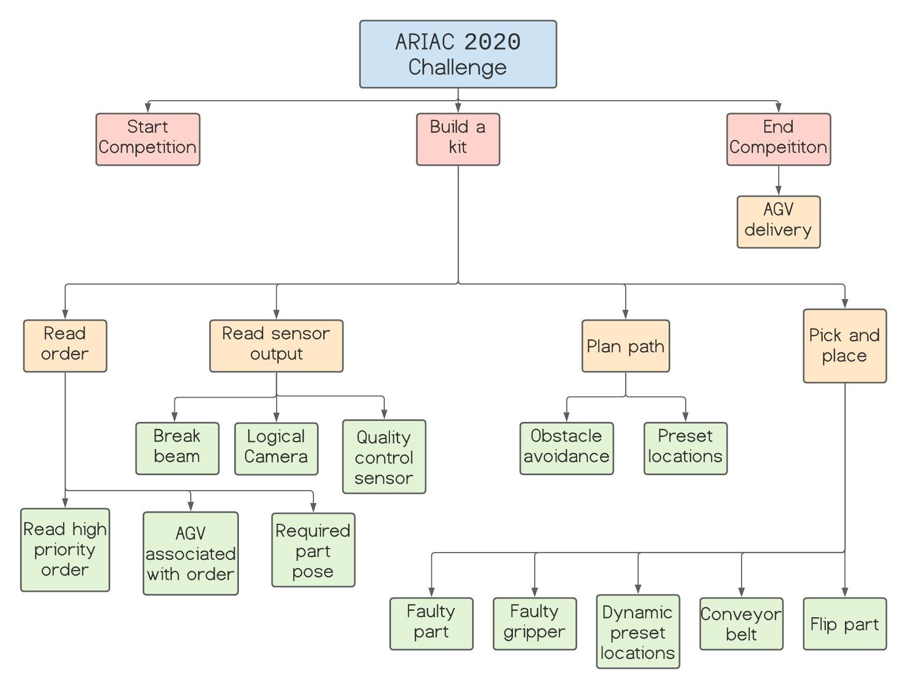
Task Analysis

Slide 6
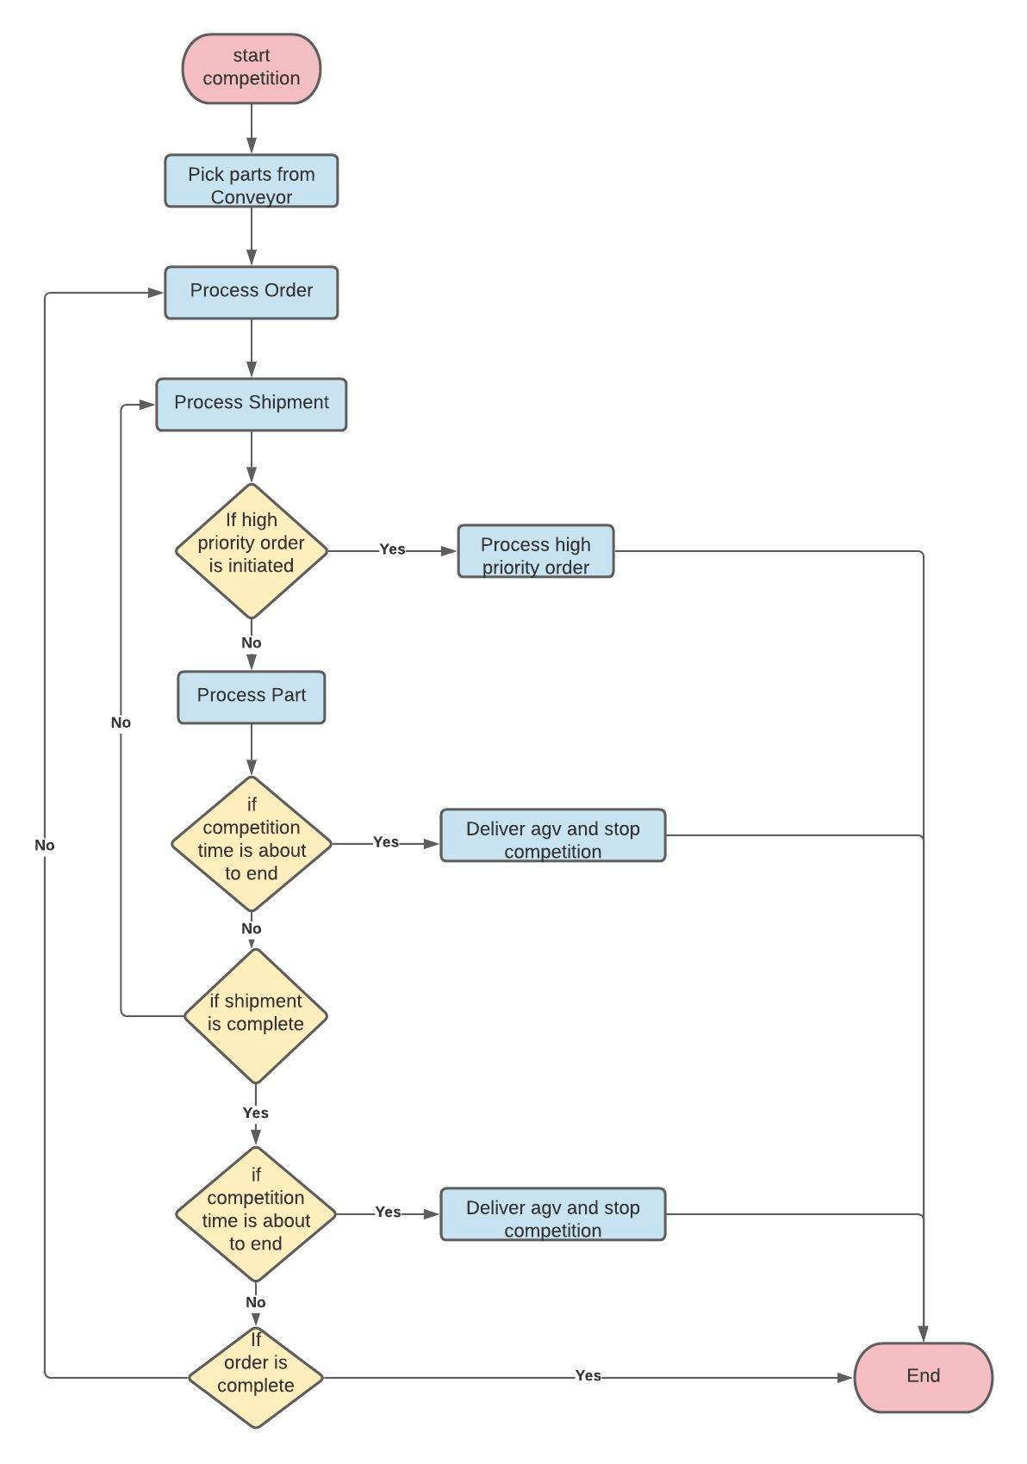
Competition Flowchart
This flowchart represents the basic architecture of the behaviour of our code.
It explains the sequence of various steps/events that are involved from the start of the competition to the end. This includes the basic structure of the different processes that are involved in building a kit.

Slide 7
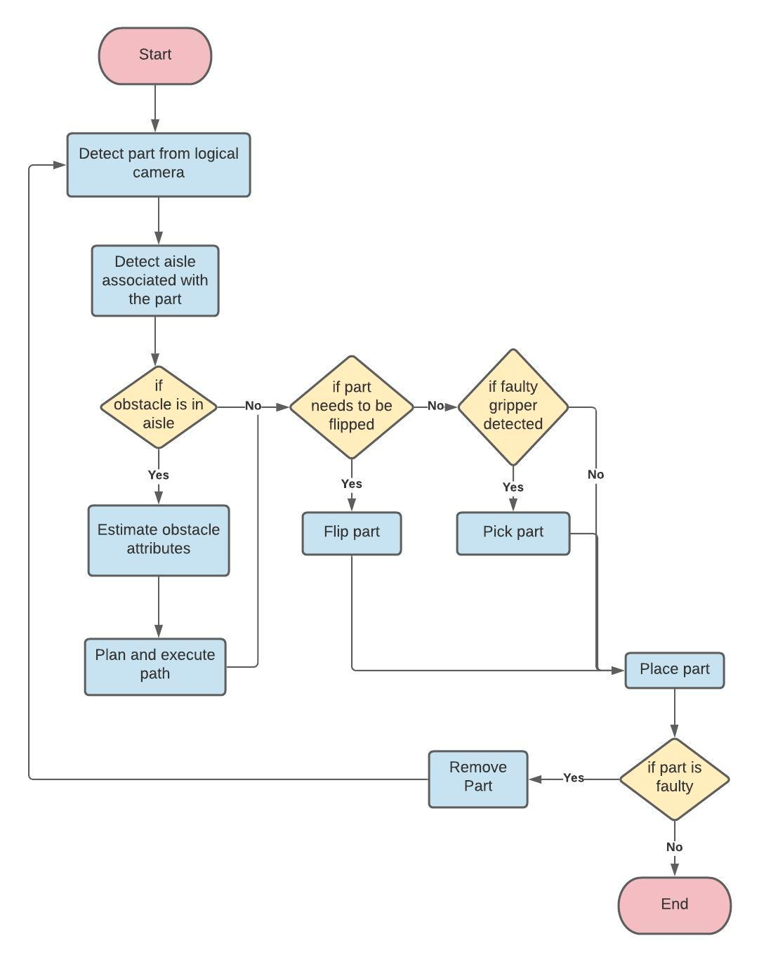
Process Part Flowchart
The flowchart represents the process part function that is a key part of our code.
It explains the sequence of various steps/events that are involved from detecting the part to delivering the part to the appropriate AGV.

Slide 8
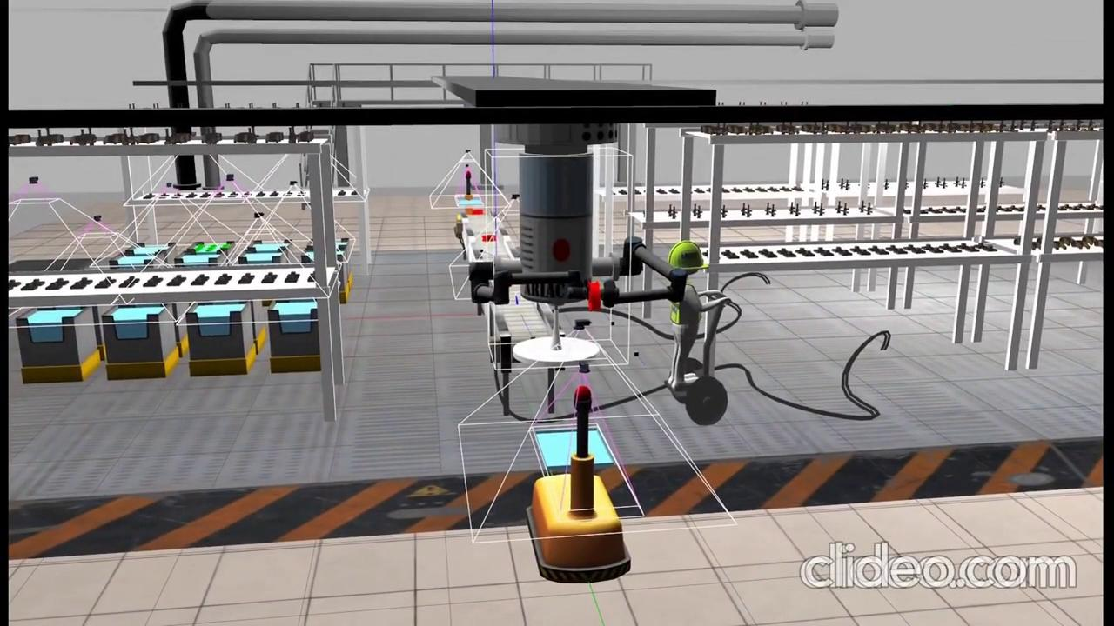
Flipping part

Slide 9
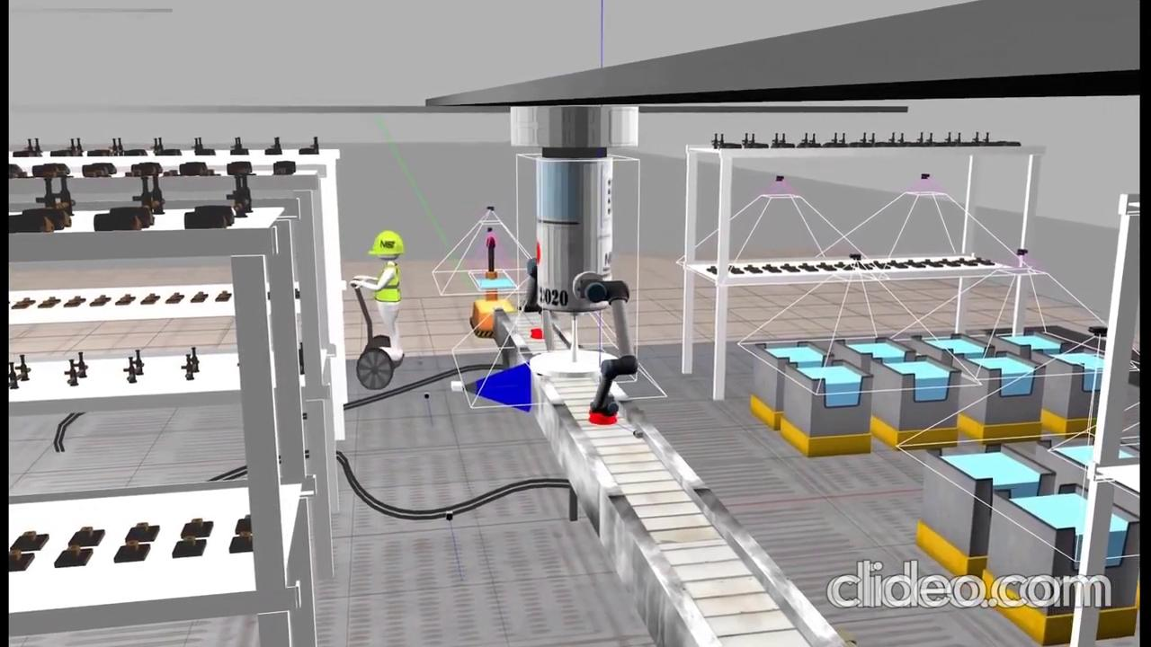
Conveyor Belt

Slide 10
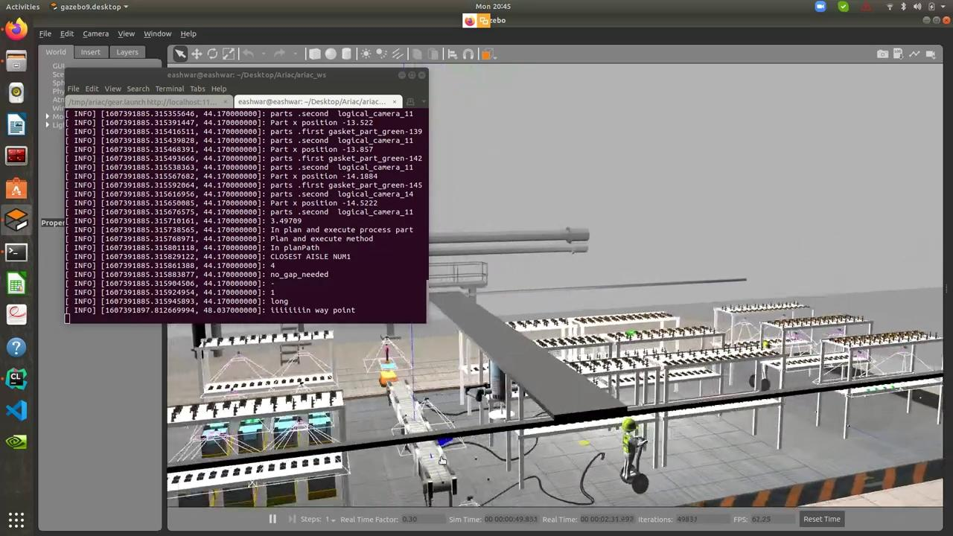
Obstacle Avoidance (Without gap)

Slide 11
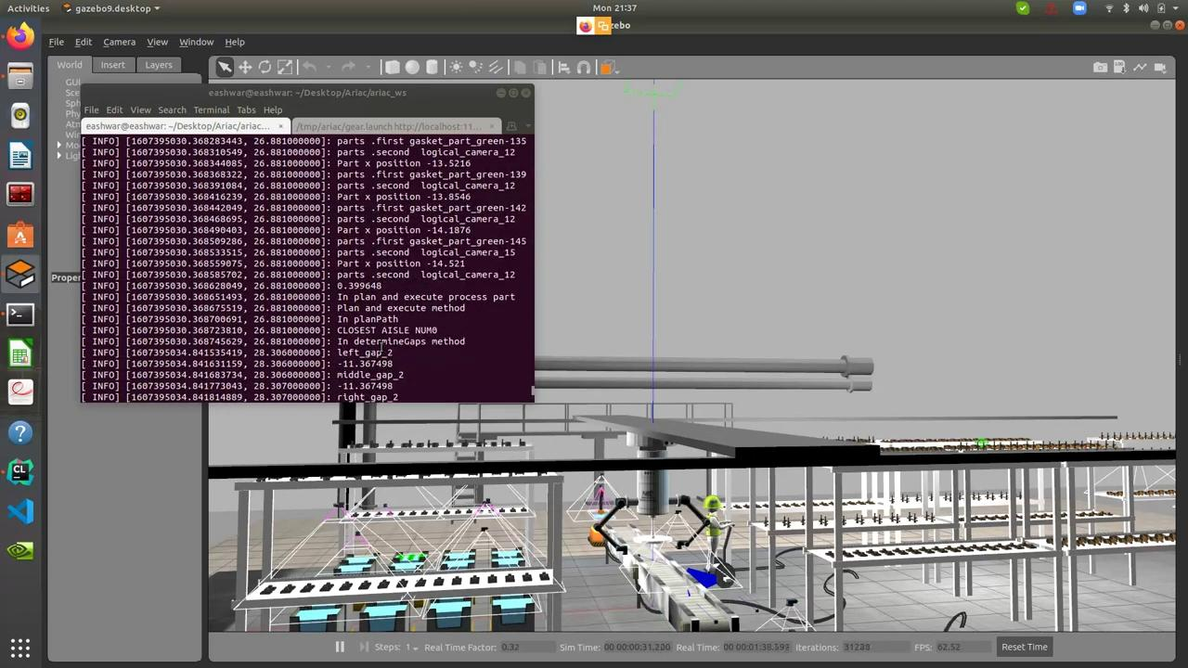
Obstacle Avoidance (With gap)

Slide 12
Sensor Blackout
For our implementation of the sensor blackout challenge:
Store detected part
Sensor blackout occurs after placing faulty part
Duplicates in published parts
False parts detected

Slide 13
High Priority Order
For our implementation of the high priority order challenge:
Check size of the order after placing each part.
If occured, check AGV number to deliver high priority order.
If high priority order needs different agv, then we execute the order.
If high priority order needs same agv, we remove unwanted parts in the agv and reposition common parts.
We then process the remaining parts of the high priority order.
After completing the high priority order, the gantry moves to the stored state of the previous order and completes it.

Slide 14
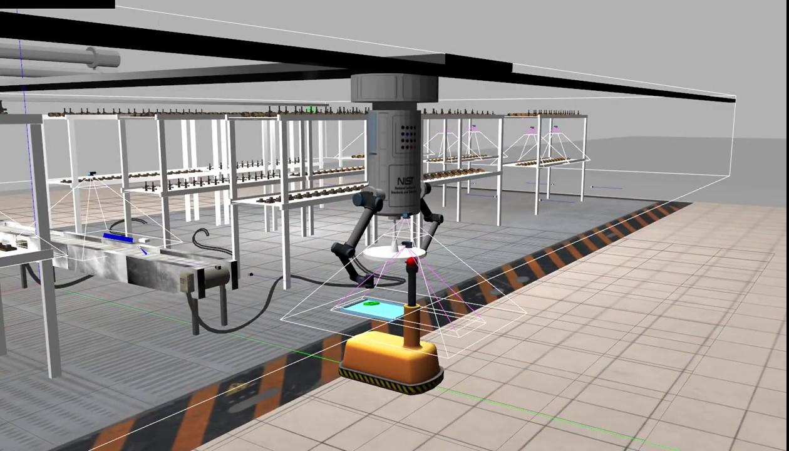
Faulty Part

Slide 15
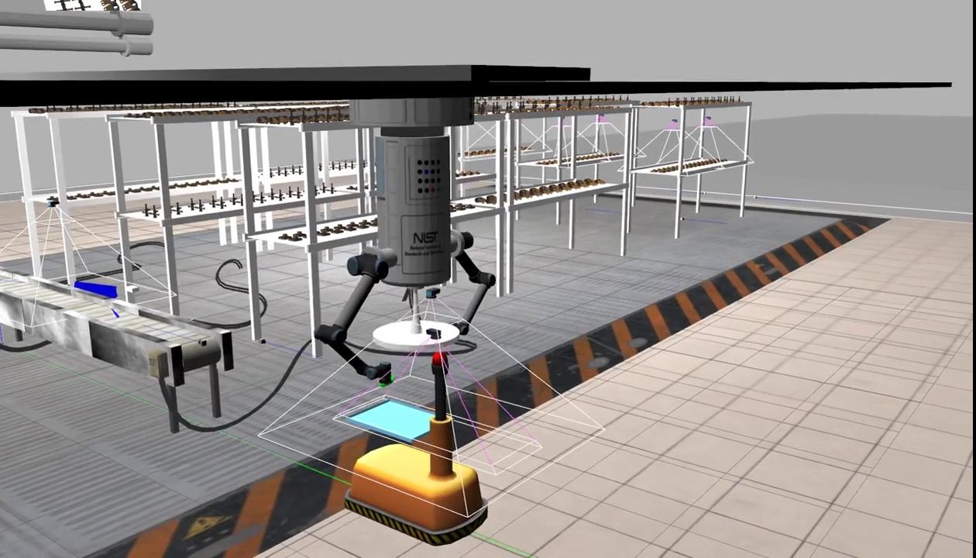
Faulty Gripper

Slide 16

Dynamic Preset Locations

Slide 17
Cost Analysis
For our simulations, the cost breakdown is as follows:
The total cost (TC) is found to be $10,100 ⇒ Cost Factor (CF) = BC/TC, where BC = $10,000
⇒ CF = 10,000/10,100 = 0.99
Sensor | Quantity | Cost per sensor ($) | Total cost
Logical Camera | 17 | 500 | 8500
Break beam | 13 | 100 | 1300
Quality Control | 2 | 100 | 200
Laser Profiler | 1 | 100 | 100

Slide 18
Problems faced
Some of the problems we faced during the implementation of the agility challenges include:
The preset locations set for one of the parts would not work for all the parts. (solution: we implemented the dynamic preset locations)
We were not able to pick the faulty part, if the part was present at the corners of the agv tray. The Move-it! could not find a path to pick the part.
Picking the parts from the conveyor belt was difficult especially for the piston part.
If the high priority order needs to be delivered to the same agv as the previous order, it becomes very complex to deliver the agv with correct parts.
Picking the dropped part in the agv tray was difficult when the part was dropped on the edge of the tray.

Slide 19
Thank you! Questions?

